Slide 1
The purpose of this deck is to fulfill the requirement of DSI #39, Capstone Project.
Role: Budding Social Entrepreneur and Data Scientist
Audience: Investors, Businesses, General Public
Problem Statement: In today’s age where our attention is the major currency, how can we take back our attention and remain focused in our tasks? At the same time, how can we make sure we do not over-exert?
Done by: Jackie Seah

Slide 2
Productivity State Developer (PSD)
by Jackie Seah
09 Nov 2023

Slide 3








Do you have these applications on your phone?

Slide 4
Social media use is highly prevalent in Singapore
5.08m
2h 13min
7.1
Social media users in Singapore
Average time spent on social media daily
Average number of different social media platforms used in a month
Source: https://www.meltwater.com/en/blog/social-media-statistics-singapore

Slide 5
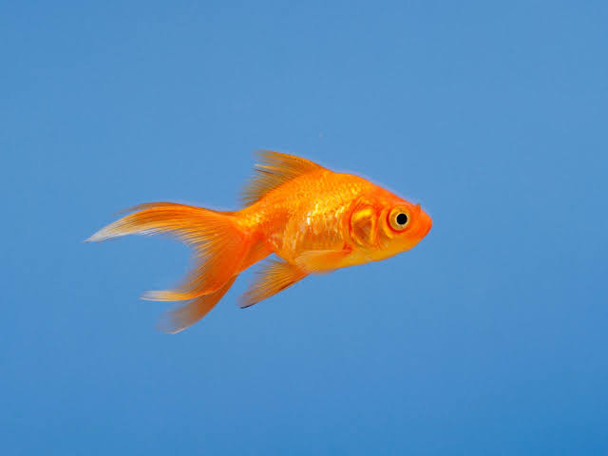
Social media apps are useful, but comes at a cost
Microsoft Canda, Consumer Insights (2015)
“Long-term focus erodes with increased digital consumption, social media usage, and tech savviness.”
Media Multitasking and Cognitive, Psychological, Neural, and Learning Differences (2018)
Did you know? Microsoft’s 2015 research suggested that the average human attention span drop from 12sec in 2000 to 8.25sec in 2015. That of a goldfish is 9sec.
“… growing body of evidence demonstrating that heavy media multi-taskers show differences in cognition, psychosocial behaviour, and neural structure.”
Source:
Attention Spans, by Consumer Insights, Microsoft Canda (2015)
https://www.ncbi.nlm.nih.gov/pmc/articles/PMC5658797/

Slide 6
Problem In today’s age where our attention is the major currency, how can we take back our attention and remain focused in our tasks?

Slide 7
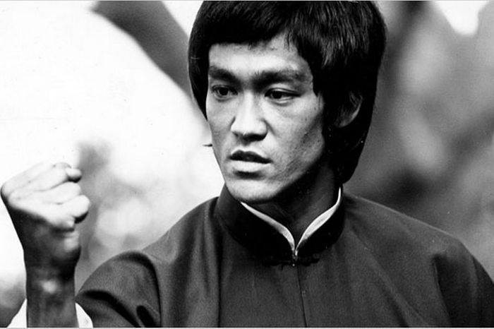
“‎The successful warrior is the average man, with laser-like focus.”
- Bruce Lee

Slide 8
Problem In today’s age where our attention is the major currency, how can we take back our attention and remain focused in our tasks? At the same time, how can we make sure we do not over-exert?

Slide 9
Proposed Solution A tool that helps users identify, quantify their productive states and provide tips on how to improve. At the same time, it will also detect signs of fatigue.

Slide 10



Process
1
2
3
4
Definition & Data Source
Data Processing
Modelling
Web Application
Extracting the features from the data source
Training a classification, machine learning model.
Designing a user-friendly tool to deploy the model to the users.
Defining the classes and sourcing for the data

Slide 11
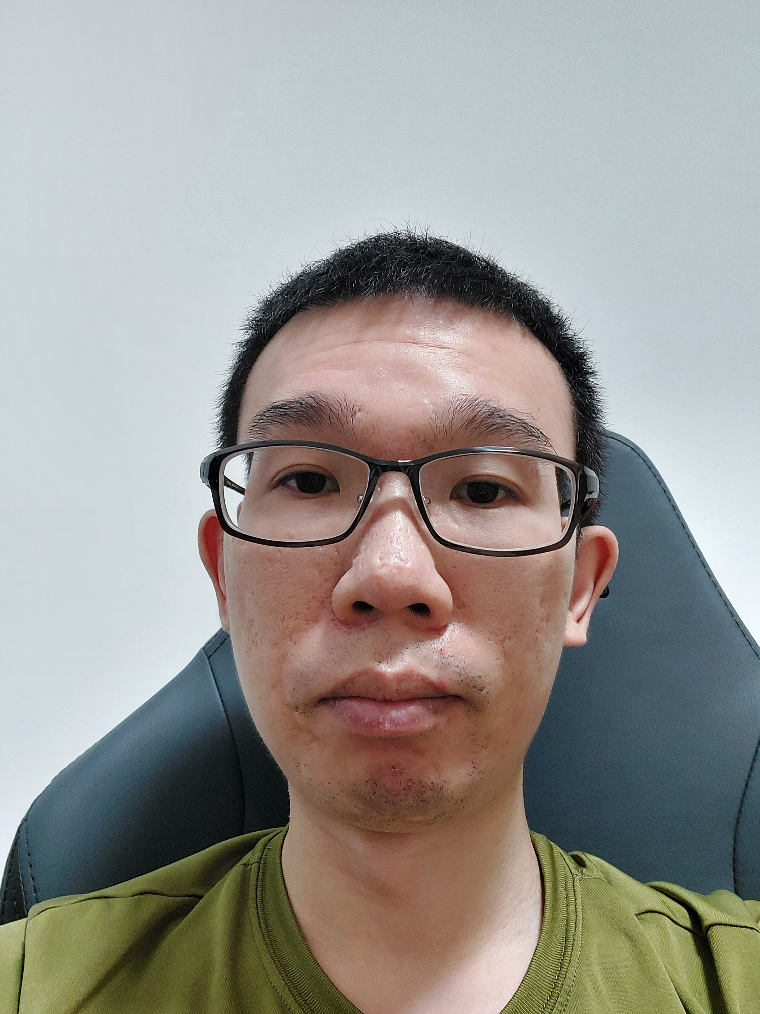
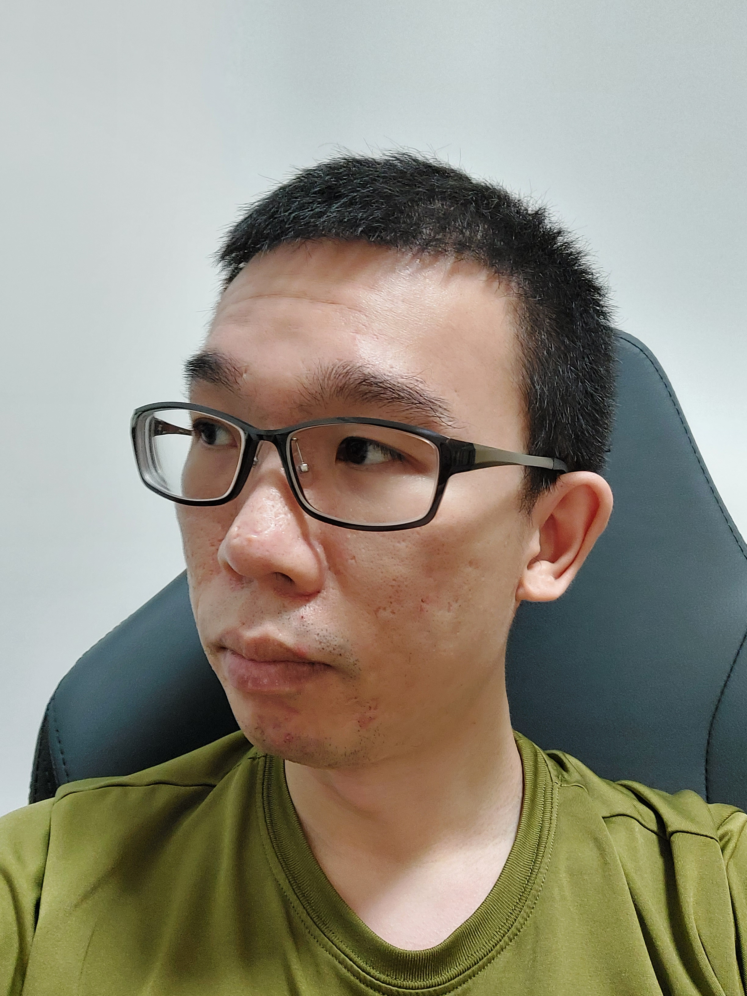
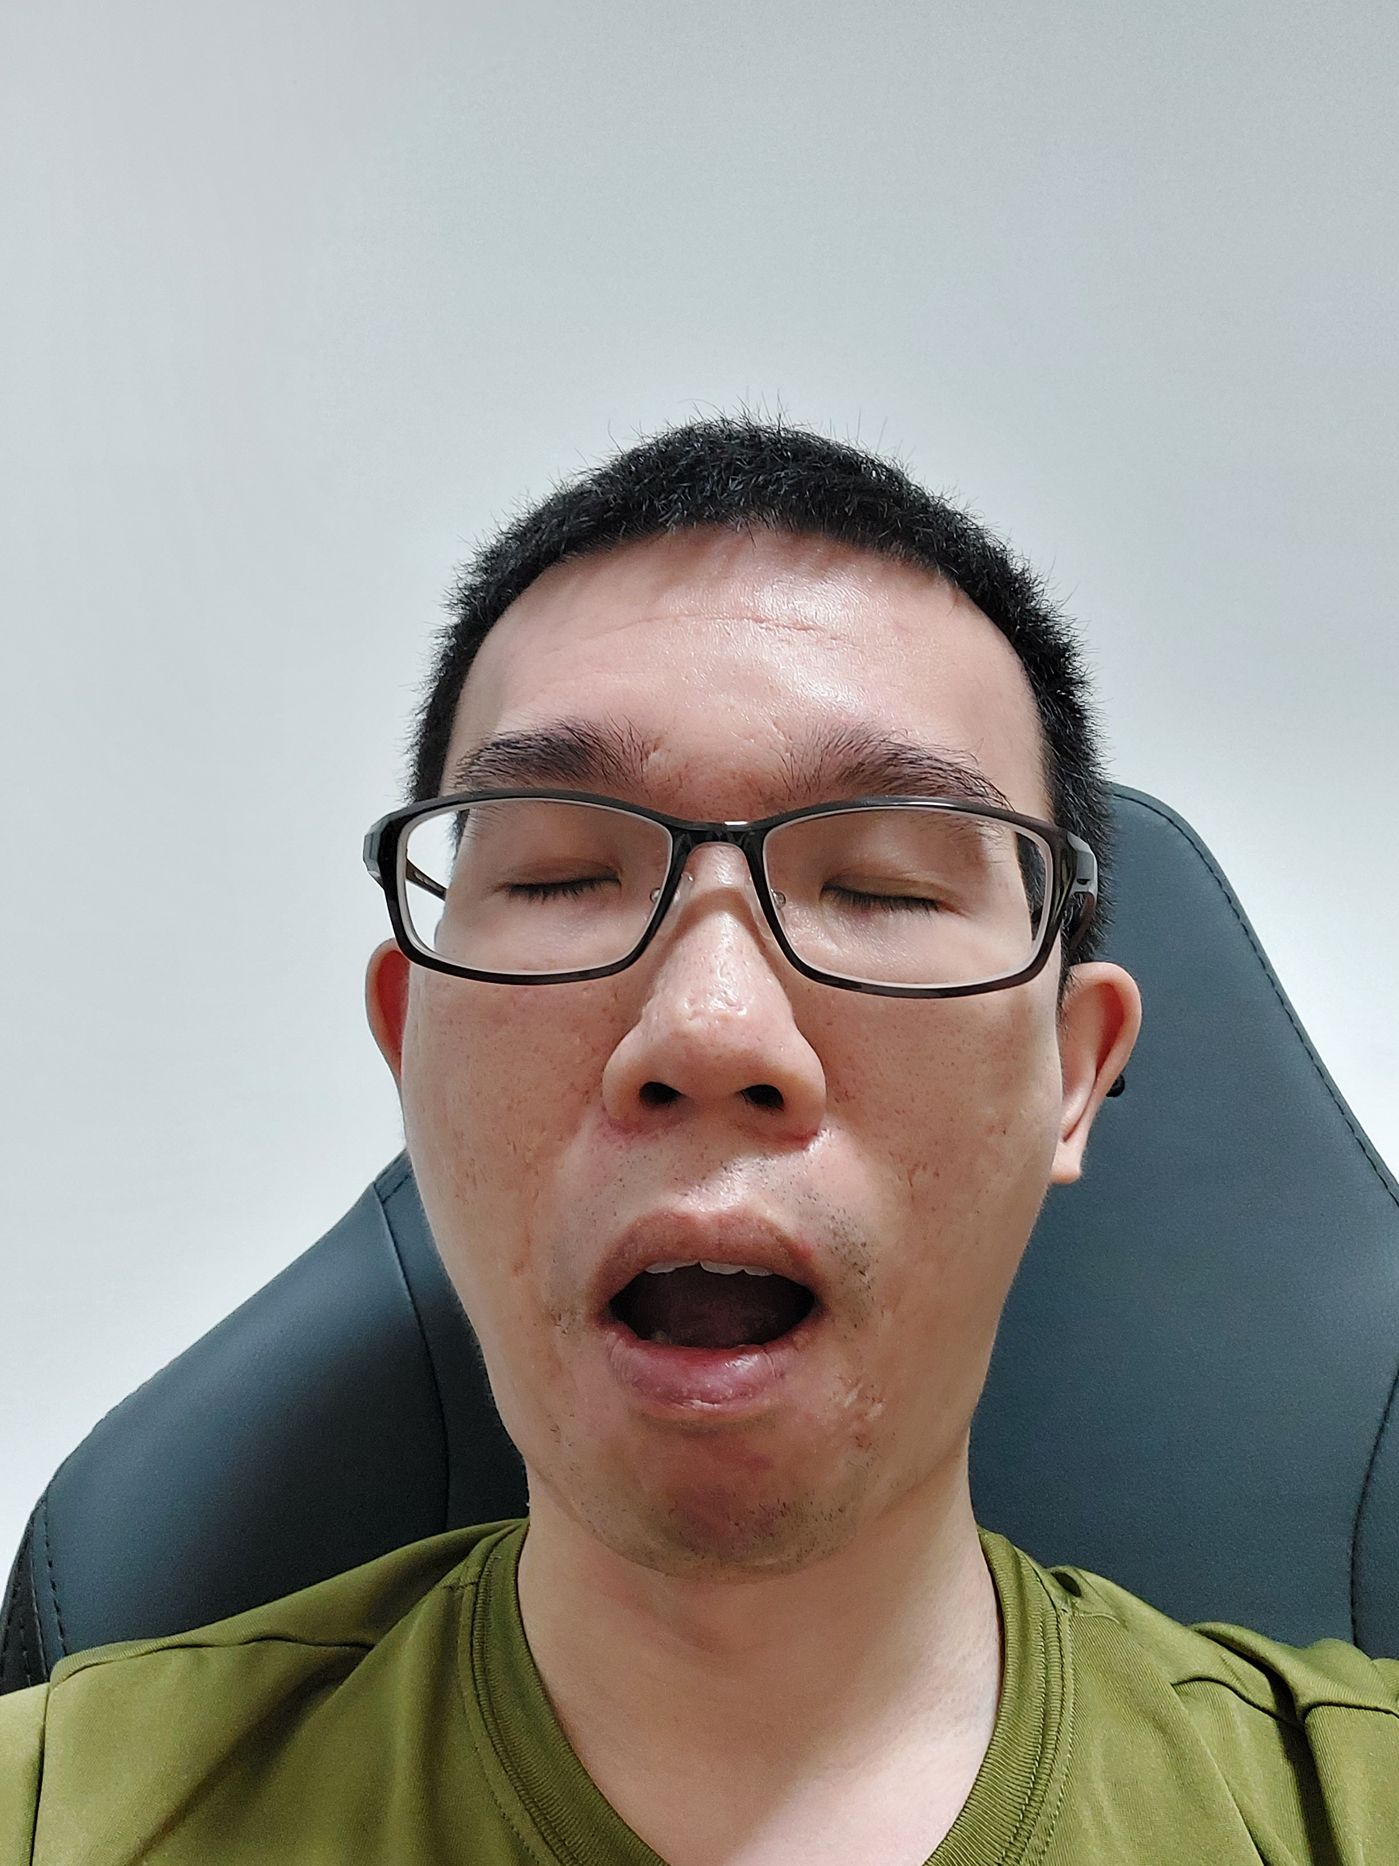
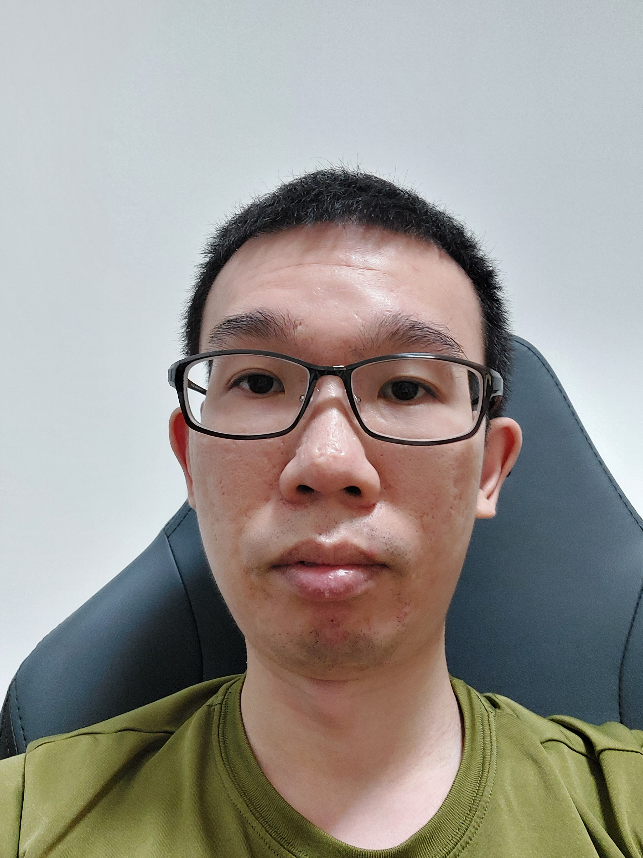
Definitions & Data Source
✔
Productive
Productive
✔
Fatigue
Not Fatigue
Recorded in 720p (1280x720), 16:9, 30fps, mp4

Slide 12
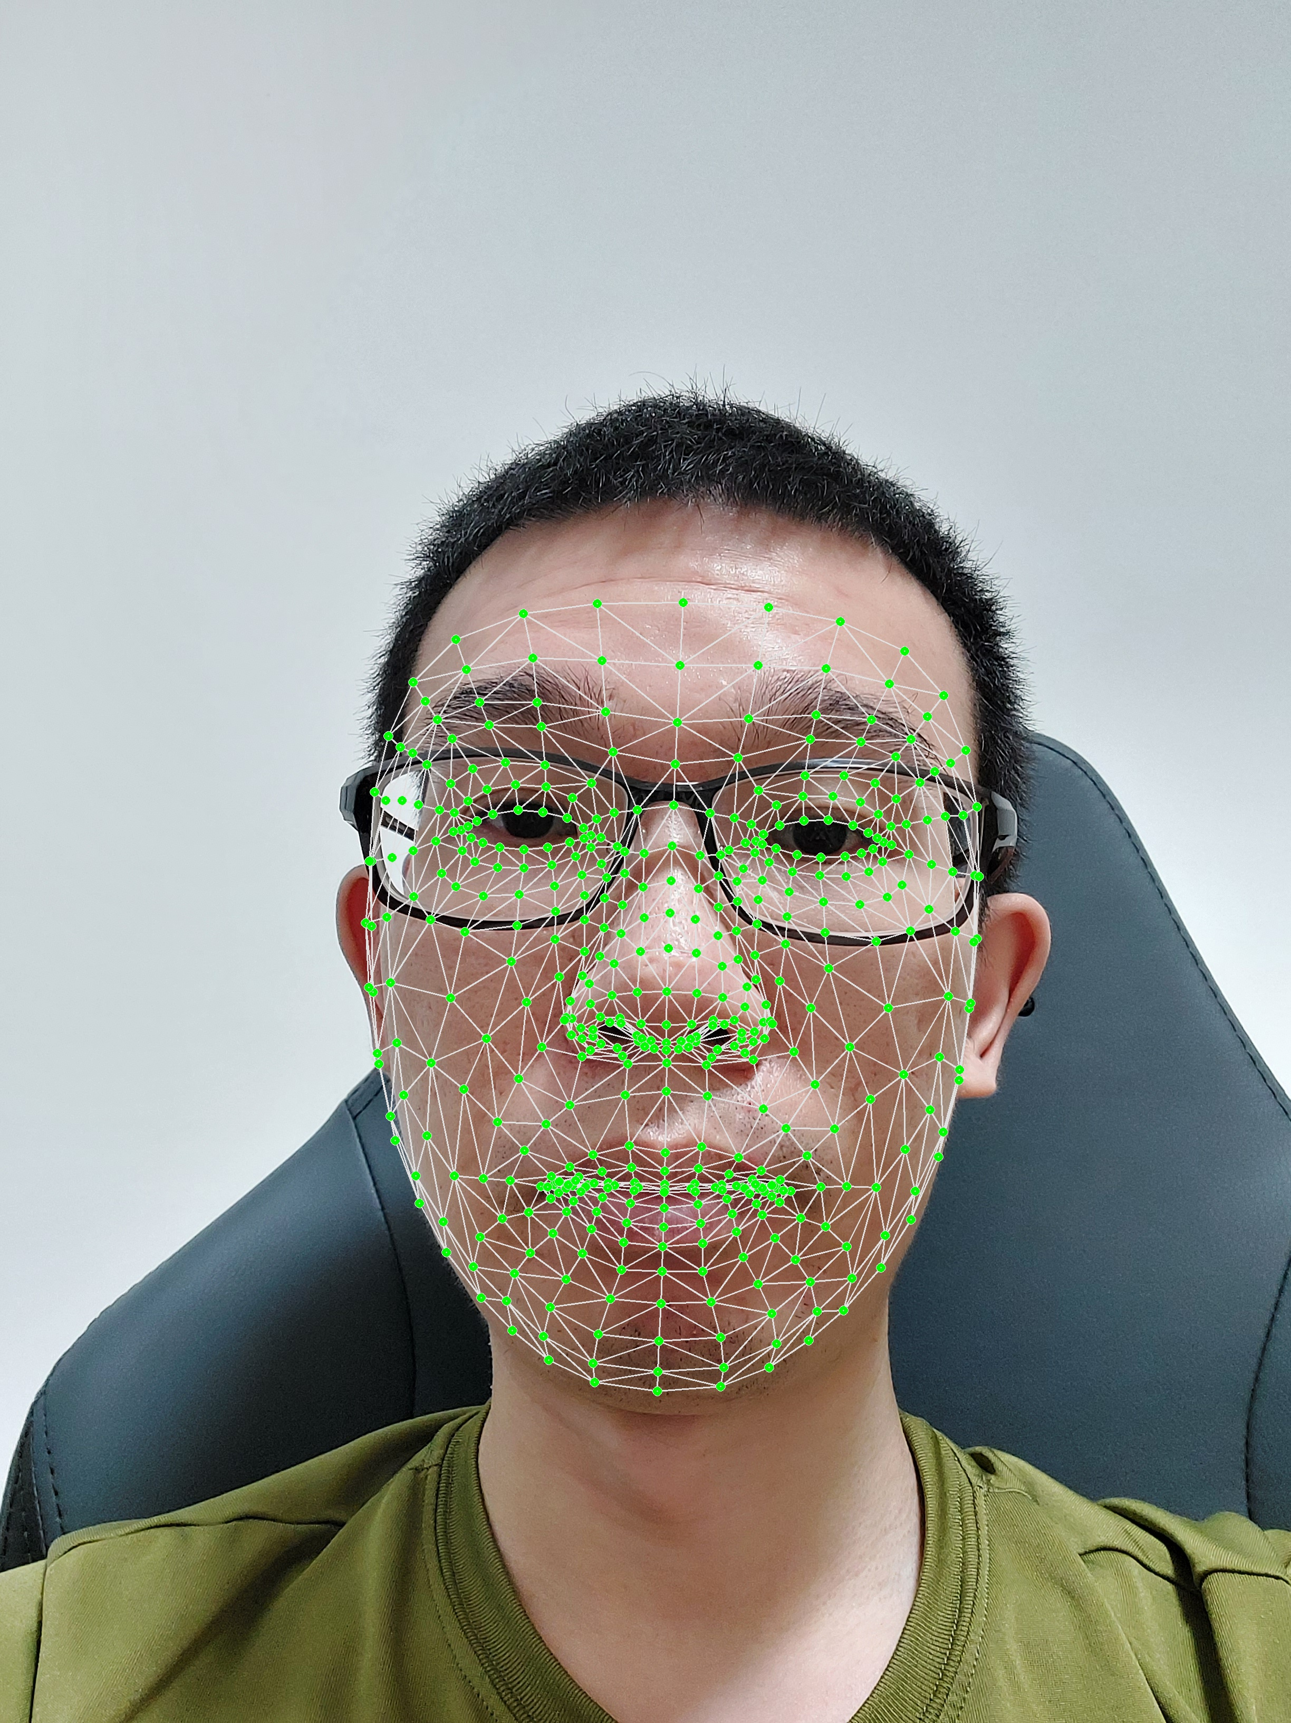

Data Processing
Slice video into frames
Detect landmarks
Extract Coordinates
Classification Model
There are 468 landmarks within the face_mesh
For each landmark, extract its x, y, and z coordinates
The coordinates are then fed into the machine learning model

Slide 13
“Ridge Classifier” was selected as the final model
 | “Productivity” Model |  |  |  | “Fatigue” Model
 | Accuracy (Train) | Accuracy (Test) | Accuracy (Cross Validation) | Runtime (sec) | Accuracy (Train) | Accuracy (Test) | Accuracy (Cross Validation) | Runtime (sec)
Logistics Regression | > 0.95 | > 0.95 | > 0.95 | 0.069 | > 0.95 | > 0.95 | > 0.95 | 0.084
Ridge Classifier | > 0.95 | > 0.95 | > 0.95 | 0.031 | > 0.95 | > 0.95 | > 0.95 | 0.053
Random Forest | > 0.95 | > 0.95 | > 0.95 | 0.280 | > 0.95 | > 0.95 | > 0.95 | 0.417
Gradient Booster | > 0.95 | > 0.95 | > 0.95 | 8.148 | > 0.95 | > 0.95 | > 0.95 | 14.254
Evaluation Criteria:
Accuracy Score: Closer to 1, the better.
Train vs Test Score: Difference of less than 0.1 suggest no sign of overfitting
Cross Validation: Closer to 1 suggest model will have good generalisation.
Runtime: Lower the better.

Slide 14


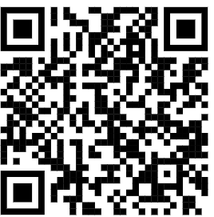

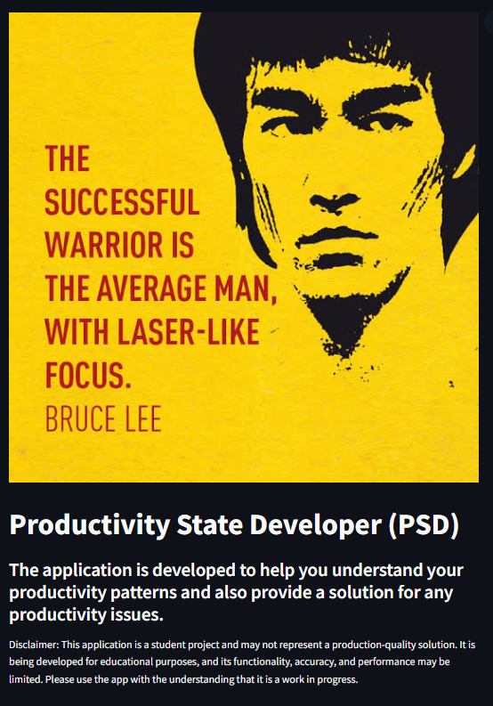
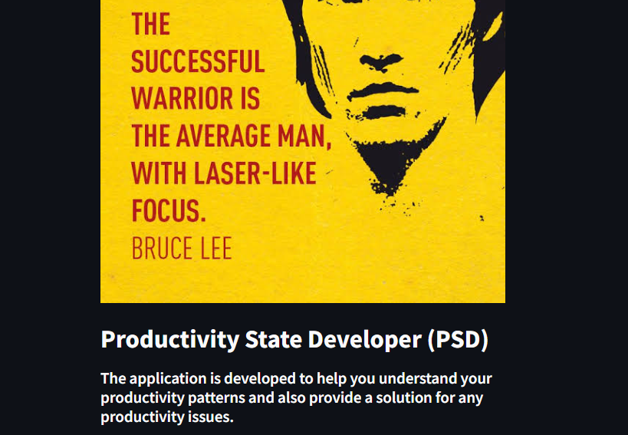
Demo
https://laser-focus.streamlit.app/

Slide 15
Summary
Problem: In today’s age where our attention is the major currency, how can we take back our attention and remain focused in our tasks? At the same time, how can we make sure we do not over-exert?
Result:
2 classification models that are accurate, reliable, and shows consistent performance across different datasets.
A “live” web application that allow users to upload, analyse their own data, and get tips on how they can improve.

Slide 16
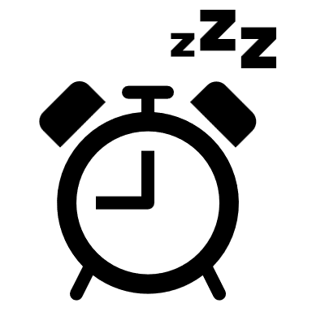


Future work aims to improve model and explore other use cases
Improve fatigue classification
Improve productivity detection
Alternative Use Case
Expand from a binary classification into a scale. (e.g. 7-point Stanford sleepiness)
Consider more practical constraints like use of a secondary monitor.
Monitoring of off-site employees.
Detect early signs of burnout in employees

Slide 17
Thank you for your attention

